Slide 1






Title:- Human Face Recognition by using Computer Vison (Deep Learning)
Track Name:- Manufacturing
Team Name:- Dronacharyans
Team Members Name:-
Gaurav Haritas
Rishabh Kashyap
Prateek Tanwar

Slide 2


Problem Statement
Human Face Recognition by using Computer Vison (Deep Learning)
In this project, team task is to identify the human face real time from a CCTV (For this project we will provide you Video Clip) camera with the help of computer Vision. If CCTV camera frame (image from the Video) contains multiple faces, then developed model must have capability to recognize all the faces in frame.
After recognition of faces developed, Software will return the face identity (For Example Employee Code) and Date and time of recognition in a csv file (You can also insert the record into MySQL database).

Slide 3

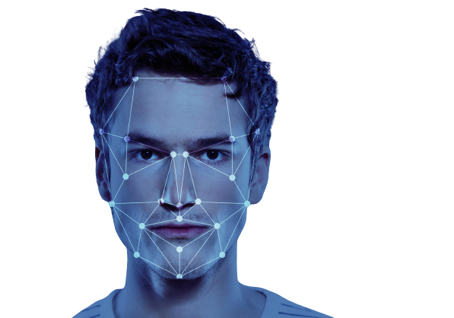
Introduction
This project aims to implement a human face recognition system using Computer Vision and Deep Learning techniques. The system will be able to detect and recognize faces from images and videos in real-time, using convolutional neural networks (CNNs) and other deep learning architectures. The system is developed using Python programming language and various libraries and frameworks such as OpenCV, dlib, OS, Datetime, Face_recognition, mysql.connector
The primary objective of this project is to build an accurate and robust face recognition system that can detect specified persons from provided images in a cctv video and their data is getting store in mysql database with date and time.

Slide 4


Our Proposed Approach
We are using face recognition library in python based on Deep Learning. It is one of the popular face recognition library in Python based on Deep Learning is called "face_recognition". This library allows you to easily recognize faces in images or videos using deep learning techniques. The "face_recognition" library is built on top of the deep learning framework called "dlib", which is written in C++ but has a Python API. The library uses a pre-trained deep neural network model to identify and locate faces in images, and then compares these faces to a database of known faces to perform recognition.

Slide 5

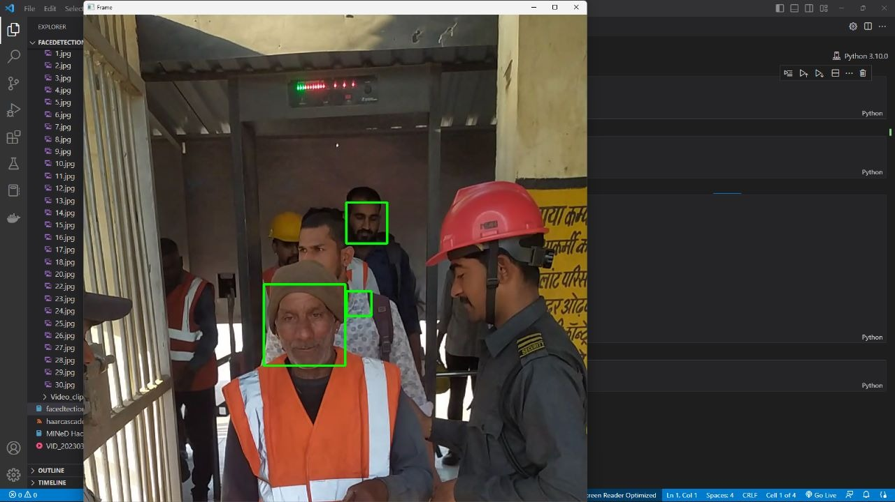
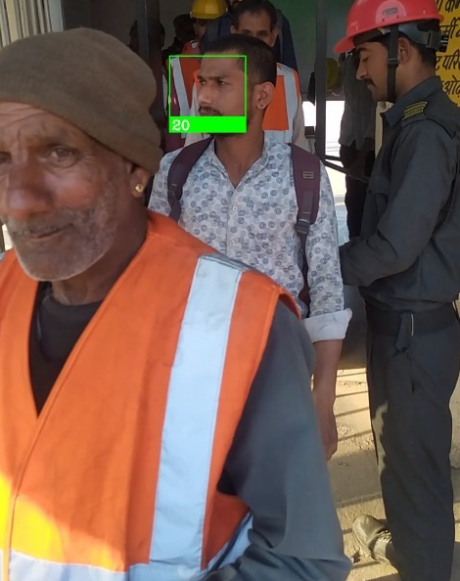

Why choose our solution
We have built our model using dlib’s state-of-the-art face recognition which is
built with deep learning. The model has an accuracy of 99.38% on the
Labeled Faces in the Wild benchmark. In other haarcascade_frontalface_default model from OpenCV it was recognising the shirt of the person as another person and in our model it is detecting accurately as shown below :-
haarcascade-frontalface_default
dlib

Slide 6

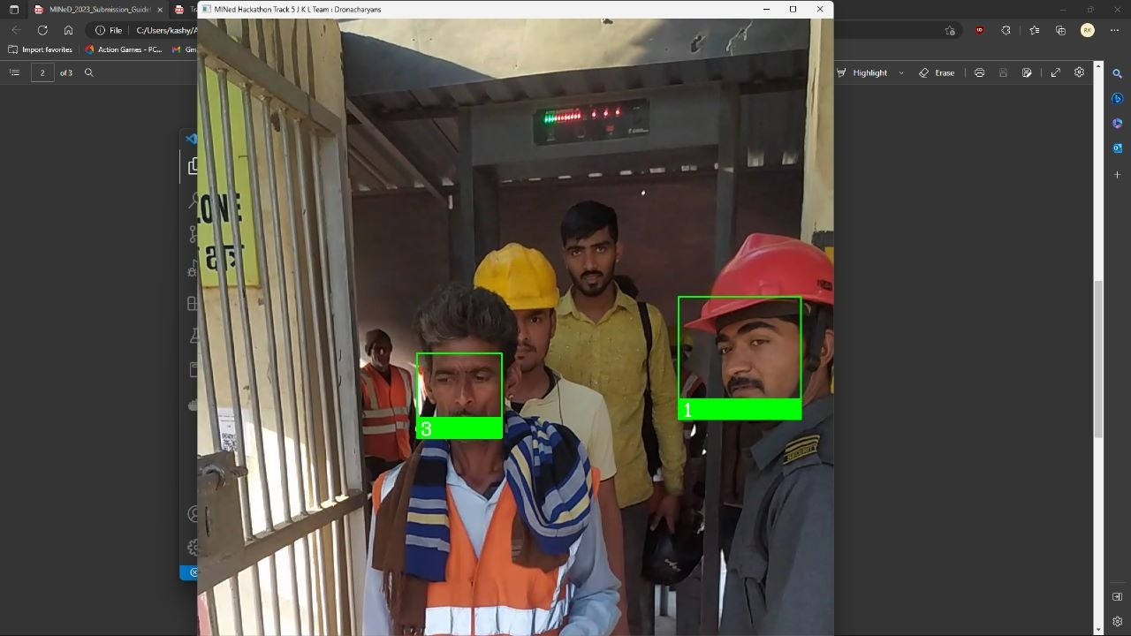
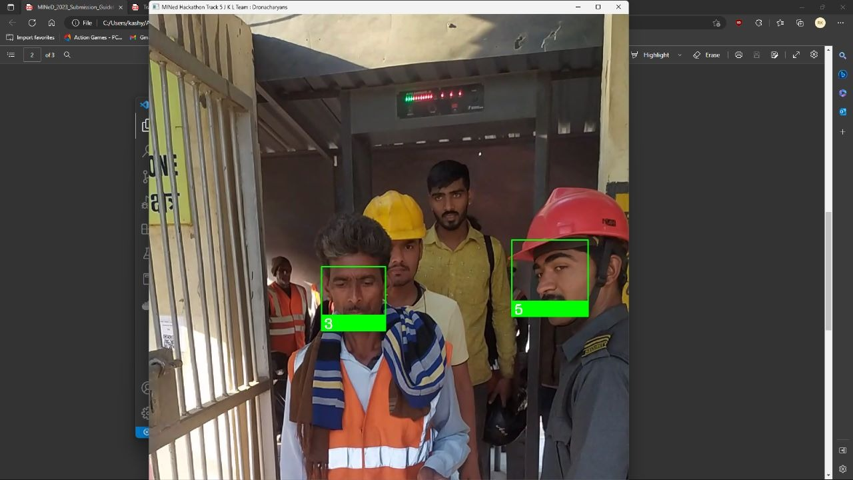
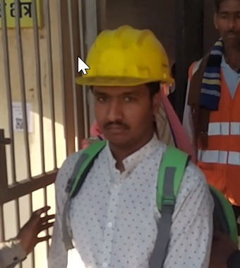

Limitations
It is detecting the security guard in the video which is not to be detected as the data of security guard is not present in the dataset. The model is detecting the Security guard as the other two persons present in the dataset. It is where the model is lagging behind in 1% inaccuracy. The demonstration is shown below:-

Slide 7
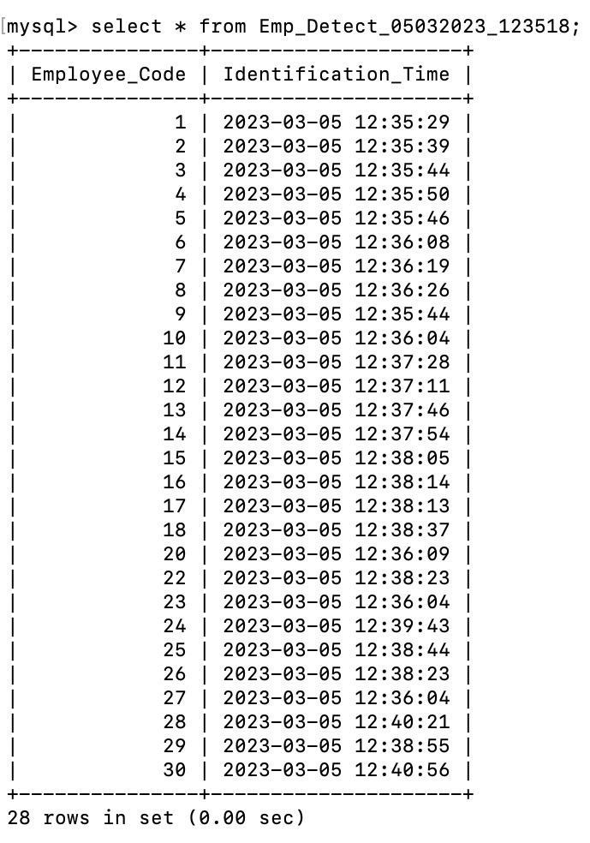
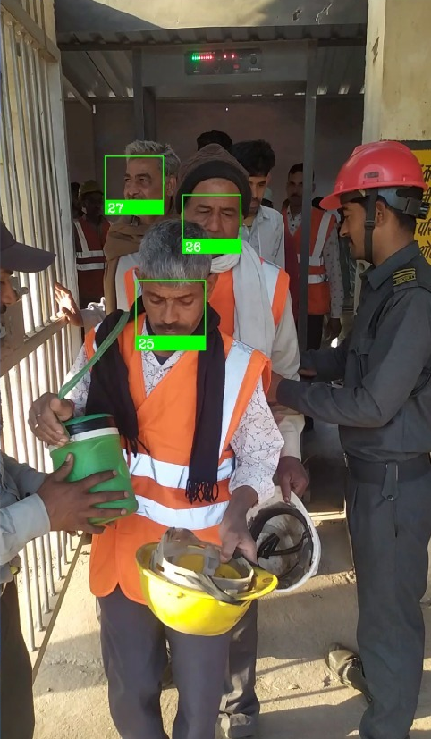
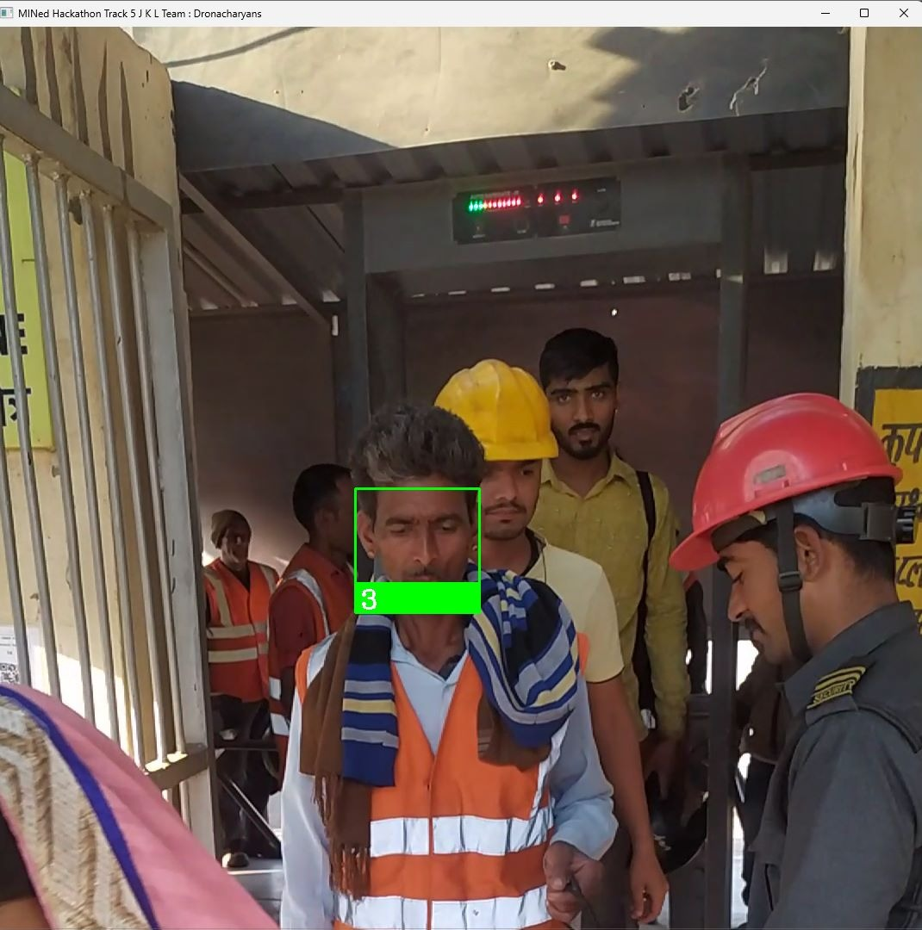
Screenshot Of Solution

Slide 8

References
https://pypi.org/project/face-recognition/
http://dlib.net/
http://vis-www.cs.umass.edu/lfw/
https://docs.opencv.org/4.x/
https://pypi.org/project/mysql-connector-python/
https://dev.mysql.com/doc/connector-python/en/
https://docs.python.org/3/library/os.html

